Slide 1

Demonstration of MRI
by Alex Hoekstra

Slide 2
Quickstart (Teacher only)
Start simulation with button below
Switch on the B1 field with button B1
Set B₁ frequency to 1.229 with buttons or keys (make sure or select B₀=4000 and B₁=400)
Reset speeds and set angle to a non-zero value with Reset button
Also try other values for B₁ frequency, push reset to see effect
See resonance live and in analysis plots after closing simulation window
Start sim

Slide 3
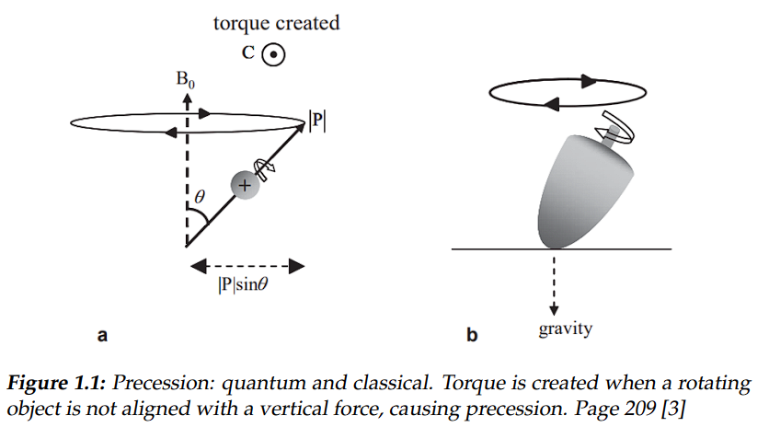

Theory
Magnetic Resonance Imaging

Slide 4
Simulation of MRI
The program simulates MRI, there are several choices you can make and setting you can choose.
We have a mode 1 and a mode 2 simulation en we can set effect A varying from to 10 to 50
But first some background info….

Slide 5
We can choose to simulate B₁ with different properties
Quit
B₁ magnitude is the strength of the dynamic magnetic field perpendicular to B₀
B₁ frequency controls how fast B₁ oscillates
Magnitude
Frequency

Slide 6
B₀ simulation
Quit
Magnitude sets the severity of B₀, you can set the magnitude to varying levels. B₀ is the constant, stationary field.
Choose a button to start your simulation with the magnitude you want
B0 = 2000
B0 = 4000
B0 = 6000
B0 = 8000
Back to menu

Slide 7
Magnitude simulation
Quit
Magnitude sets the severity of B₁, you can set the magnitude to varying levels. B₁ is the driving, oscillating field according to B₁ frequency.
Choose a button to start your simulation with the magnitude you want
B1 = 50
B1 = 100
B1 = 200
B1 = 400
Back to menu

Slide 8
Frequency simulation
Quit
Here you can choose the frequency of B₁
f = 0.5
f = 1
f = 5
Back to menu

Slide 9
Choosing to simulate friction (advised) or frictionless
In reality there is friction in the compass demonstrator. When no friction is used, old frequencies stay in the oscillation unless B1 is switched off during F1 change and the reset button is pressed.
Normal friction and light friction are preset. Use buttons below to see the effect
Normal friction
Light friction
No friction
Start sim

Slide 10
Tissue files
Tissue files are stored in the data folder. It really are CSV files, which can be edited by any text editor like notepad on Windows
New tissue files can be added by the teacher/instructor
Selection is done via the settings.py or use the buttons below.
No tissue
Pattern
Start sim
Diagonal line
Lump in middle

Slide 11
End
Close this window

